Slide 1


NASA SPACEAPPS 2019
KEEP IT COOL
Team Kugelblitz
Siddharth Srivastava
Yash Damania
Abhishek Deshpande

Slide 2

THE HUMAN PROBLEM
CLIMATE CHANGE AWARENESS
ESOTERIC STUDIES AND DATA - CHALLENGE TO HUMAN INTUITION

Slide 3

IMPACT
Chaos Theory
No time left
Unprecedented effects
Democratize data for better policies

Slide 4
DESIGN CHALLENGES
Behavioral economics
Human-friendly interaction with climate change
Has to be intelligible and memorable

Slide 5

NASA DATA
GISTEMP V4 SURFACE AIR TEMPERATURE
SURFACE EXCHANGE OF C02
https://data.giss.nasa.gov/co2_fung/
https://data.giss.nasa.gov/gistemp/

Slide 6
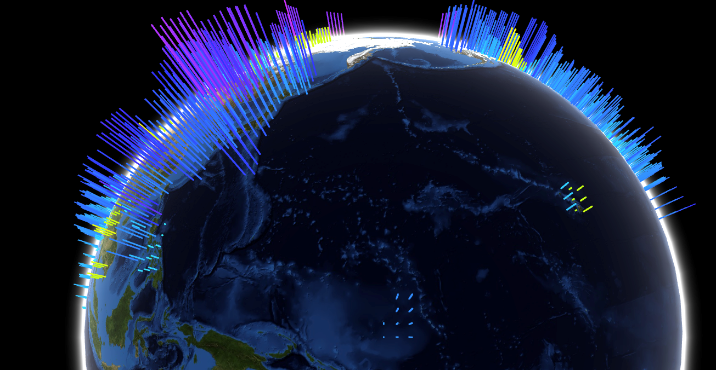
Demo
TECHNOLOGY
PERSONAL DEVELOPMENT
BUSINESS AND MARKETING
SCIENCE
Presentations are communication tools that can be used as demonstrations, lectures and more.
Presentations are communication tools that can be used as demonstrations, lectures and more.
Presentations are communication tools that can be used as demonstrations, lectures and more.

Slide 7
DATA PIPELINE
GLOBAL MEAN TEMPERATURE
CO2
{MAP TO}

Slide 8
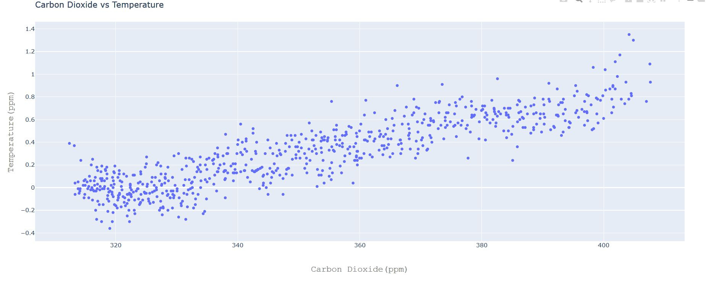

Slide 9
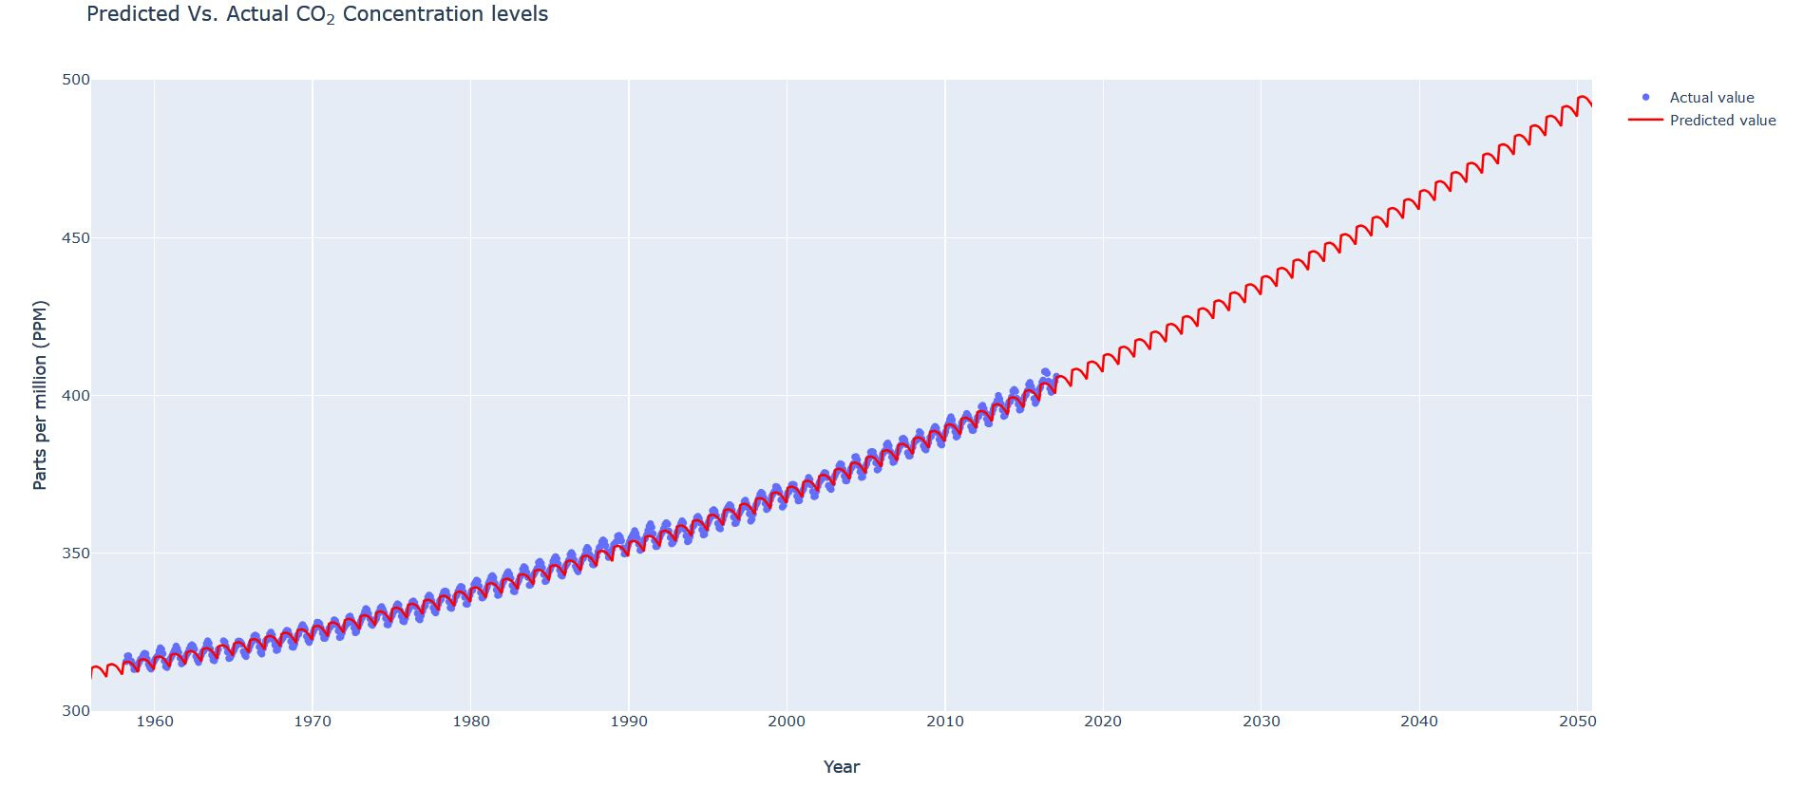

Slide 10
APPLICATIONS
EXPANDABLE FOR MORE PARAMETERS
GENERAL FRAMEWORK TO VISUALIZE ALL SCIENTIFIC DATA

Slide 11
Other factors
Sea Surface Temperature
Ice sheet levels
Arctic sea ice level
Ocean acidifcation

Slide 12
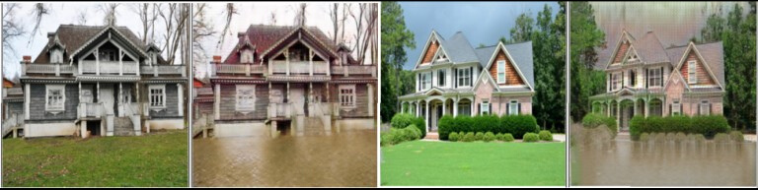
Roadmap
1. CycleGANs (https://github.com/srivastava41099/cygan)

Slide 13
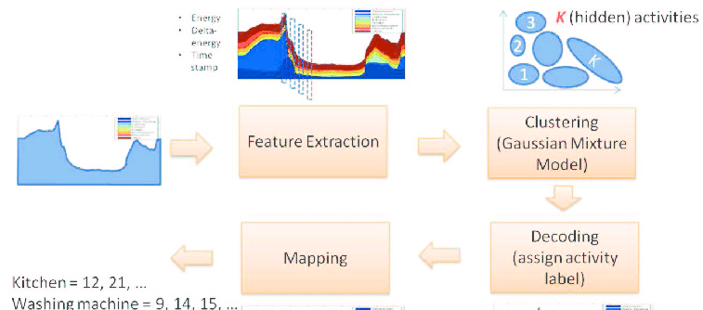
2. Energy Disaggregation (https://github.com/srivastava41099/energy-disaggregation)

Slide 14

FUTURE
HUMONGOUS MARKET
INTERACTIVE EDUCATION WITH POSITIVE FEEDBACK MECHANISM

Slide 15

The world cannot stabilize what it does not watch.

Slide 16
SIDDHARTH SRIVASTAVA
ABHISHEK DESHPANDE
YASH DAMANIA
THE TEAM
AI Research & Physics
MIT-WPU, Pune
Electronics & AI Research
MIT-WPU, Pune
Software Engineering
MIT-WPU, Pune
SRIVASTAVA41099@GMAIL.COM
ABHISHEK.DESHPANDE1131@GMAIL.COM
DAMANIAYASH@GMAIL.COM

